Slide 1
Microsoft 365 & Power Platform Development – Bi-weekly call
Your host in this call: David Warner (Microsoft)
July 7th, 2022

Slide 2




v
Agenda
Latest on PnP Framework and Core SDK extension
Latest on PnP PowerShell
Latest on yo Teams
Latest on Microsoft Graph Toolkit
Independent Publisher Connectors
Latest on script samples
Latest Microsoft Teams samples
Latest on Power Platform samples
Picture time with the Together Mode!
Clément Olivier - Independent Publishing Connectors - Mailjet Demo
Pankaj Surti - How Microsoft Graph “Sites.Selected” work for granular permissions in SharePoint Online
Chris Kent - List Formatting – Warrior Horse Return

Slide 3
Opportunities to Participate in the community
Demo solution or technical pattern
Contribute on GitHub
Provide feedback
Great opportunity to get visibility for you or your company. Demo sample or explain how you extend or customize SharePoint Online with live demo in your projects. Reach out to team for volunteering.
Request a demo spot on the call
https://aka.ms/m365pnp/request/demo

Slide 4
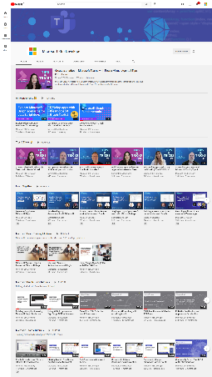
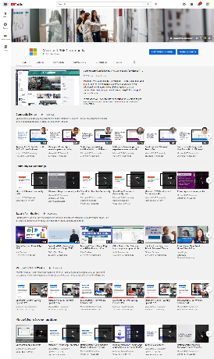
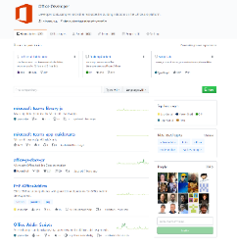
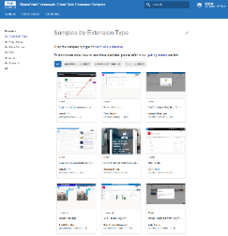
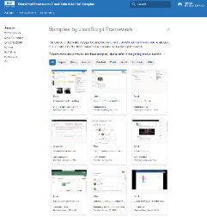
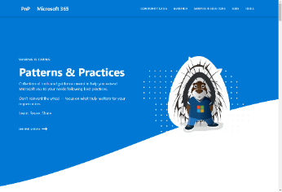
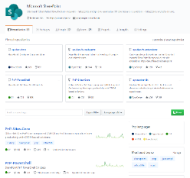
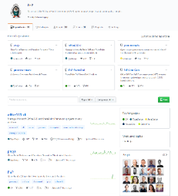
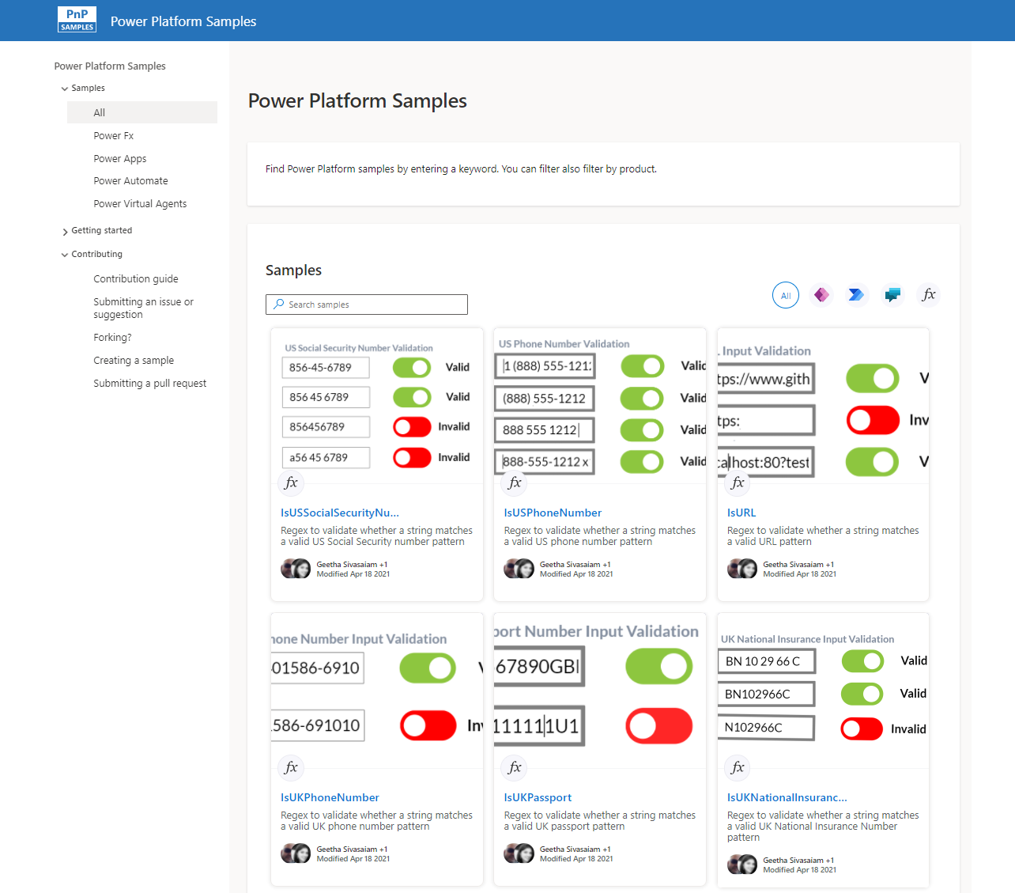
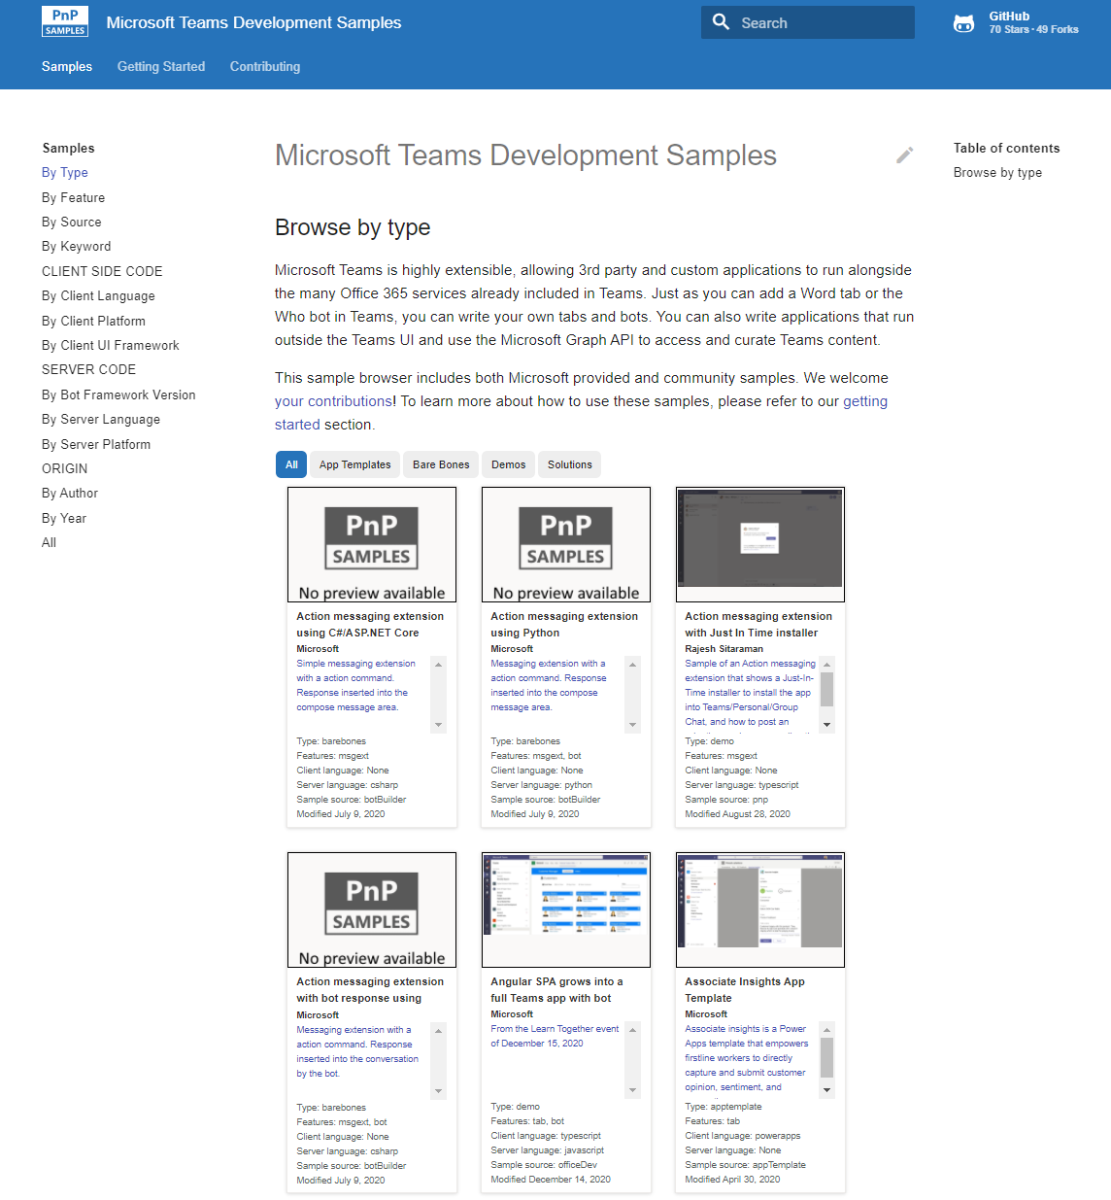
Microsoft 365 developer videos
Microsoft 365 community videos
Open-source
Sample galleries
Open-source initiatives and samples
github.com/sharepoint
github.com/pnp
github.com/officedev
github.com/microsoftgraph
aka.ms/m365/samples
aka.ms/teams-samples
aka.ms/spfx-webparts
aka.ms/powerplatform-samples
aka.ms/spfx-extensions
aka.ms/list-formatting
aka.ms/m365/community
aka.ms/m365devyoutube
aka.ms/m365pnp/videos
@Microsoft365Dev | @m365pnp

Slide 5
Microsoft 365 developer community calls
Microsoft 365 platform (weekly) https://aka.ms/m365-dev-call
(Notice. This call is on a summer break between July 1st and 31st of August 2022)
Adaptive Cards https://aka.ms/adaptivecardscommunitycall
Microsoft identity platform https://aka.ms/IDDevCommunityCalendar
Office Add-ins https://aka.ms/officeaddinscommunitycall
Power Platform https://aka.ms/PowerPlatformMonthlyCall
Microsoft 365 & Power Platform Development (bi-weekly) https://aka.ms/m365-dev-sig
Viva Connections & SharePoint Framework (bi-weekly) https://aka.ms/spdev-spfx-call
Download recurrent invites from
https://aka.ms/m365/calls
Notes:
m365-dev-sig

Slide 6

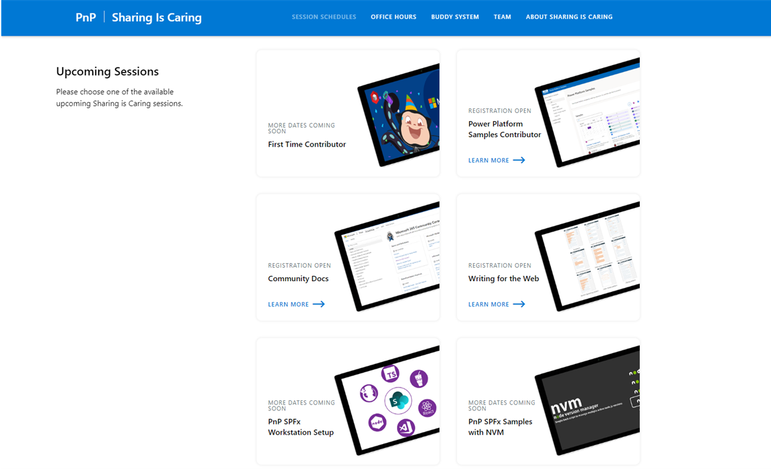
GUIDANCE
Learn how to get started in the open-source PnP community!
Upcoming Sessions:
First-time contributor
Power Platform Samples Contributor
Community Content Docs
SPFx Developer Workstation Setup
Using PnP SPFx samples w/ NVM
More than code with VS Code
First-time presenter
M365 Maturity Model Practitioners
Writing for the Web
Power Platform – Power Pages
Next Week!!
https://aka.ms/sharing-is-caring
Notes:
25 Total attendees, 16 attendees who attended both First-Time Contributors and Community Docs sessions.

Slide 7





COMMUNITY
PnP Recognition Program
Showcasing your contributions
Powered by Credly
More achievement levels coming soon
https://aka.ms/m365pnp-recognition
Notes:
25 Total attendees, 16 attendees who attended both First-Time Contributors and Community Docs sessions.

Slide 8
PnP .NET libraries A set of libraries that helps Microsoft 365 .NET developers to be more productive when working with SharePoint and Teams

Slide 9
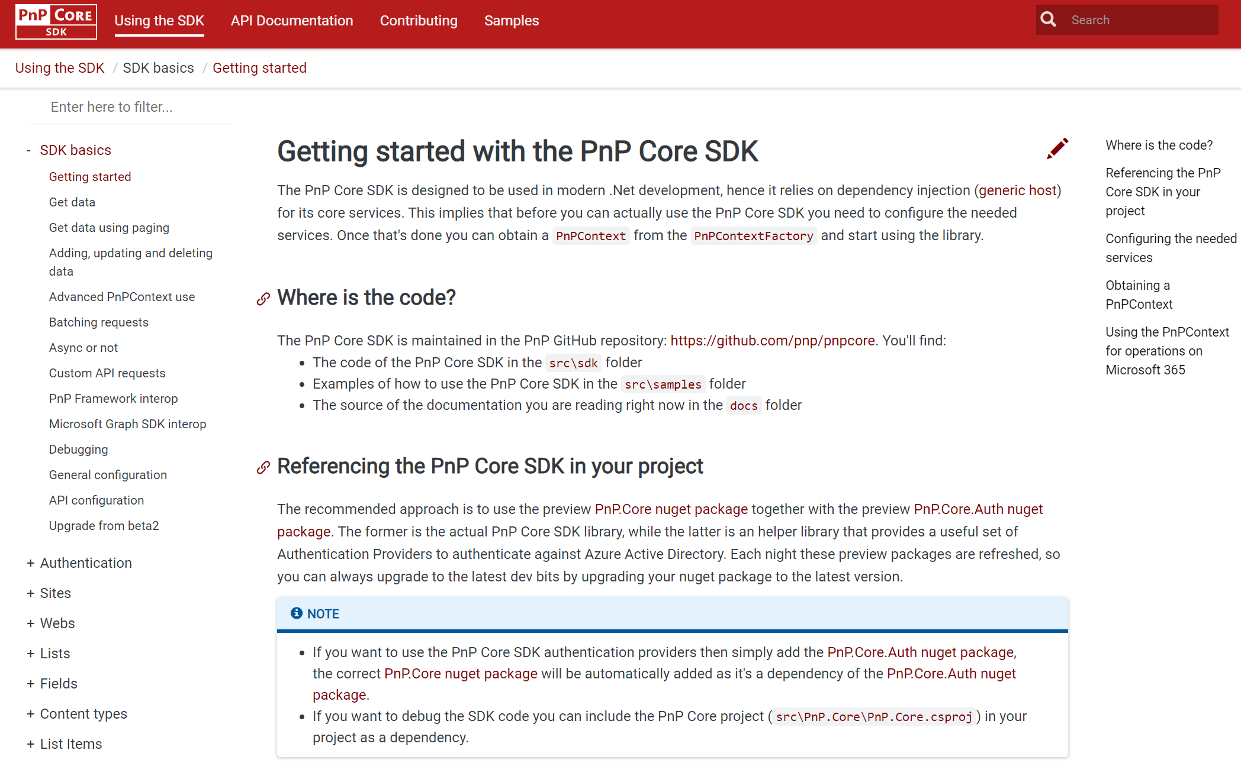
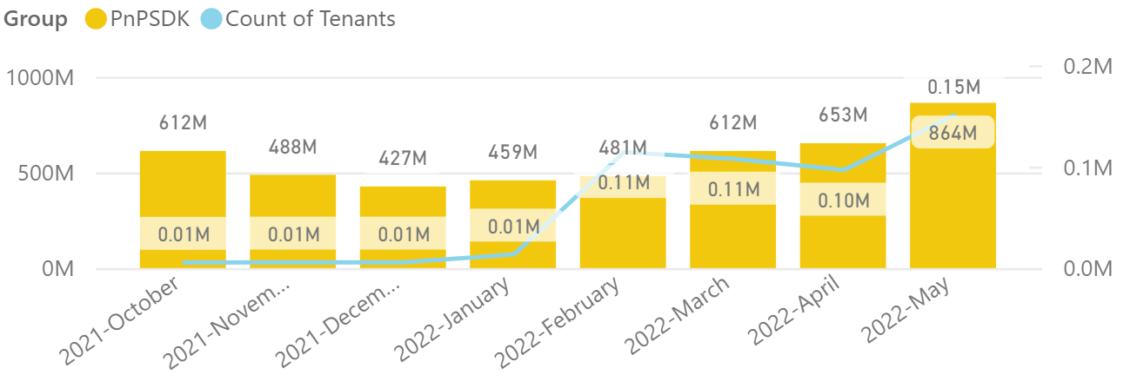
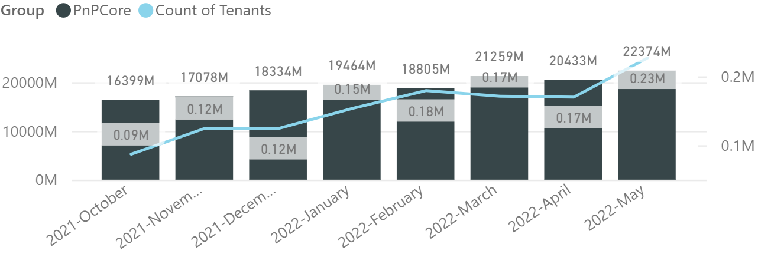

PnP .NET libraries
PnP Framework
PnP Core SDK
>220.000
tenants!
615,000 downloads!
Version 1.10.0 released!
Merge pending PRs
General fixes and improvements: 👍 Gautam Sheth and Koen Zomers
Prepping 1.11.0 (after summer break):
820,000 downloads!
Version 1.7.0 released!
Content Type hub support, file conversions and embeddable preview links : Mathijs Verbeeck 👍💪🚀
Support for link unfurling, site and file analytics: Bert Jansen👍
Fixes and improvements: Bert Jansen 👍
Prepping for 1.8.0 (after summer break)
Working on it
What key scenarios are still missing?
https://github.com/pnp/pnpcore/blob/dev/src/sdk/CHANGELOG.md
Roadmap
nuget.org/profiles/pnp
nuget.org/profiles/pnp
aka.ms/pnp/framework
aka.ms/pnp/coresdk

Slide 10
PnP PowerShell Open-source cmdlets which provide you an easy way to manage your SharePoint and Teams environment.

Slide 11
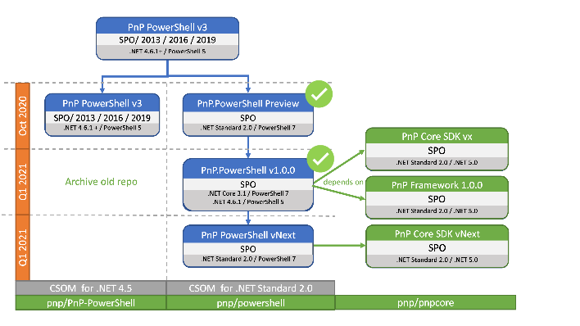
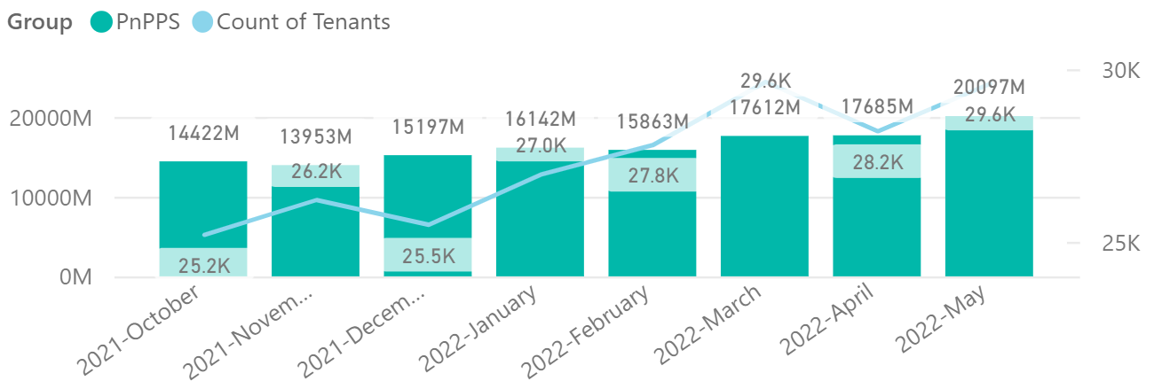

PnP PowerShell
Cross Platform PnP PowerShell
V1.11.0 released, summer break Many updates, improvements and fixes!
2.4 million downloads!
100 million cmdlets executed per day!!
Docs shifted, no more docs.microsoft.com
Documentation, Articles and tips available at https://pnp.github.io/powershell
Thinking of dropping support for PS 5, any strong objections ???
PnP PS runs in PS 5, PS 7, Azure CloudShell, Azure Functions, Azure Runbooks & Raspberry Pi
New Stuff
1.11.0 released, go check it out
Minor documentation fixes and docs updates
What next ? Would love to hear your thoughts !
Release: https://github.com/pnp/powershell/releases/tag/v1.11.0
>29.500 tenants!
Working on it
https://github.com/pnp/powershell/blob/dev/CHANGELOG.md
github.com/pnp/powershell
www.powershellgallery.com
PnP.PowerShell

Slide 12
yo teams Open-source Yeoman generator for Microsoft Teams development

Slide 13
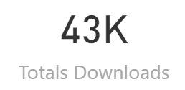
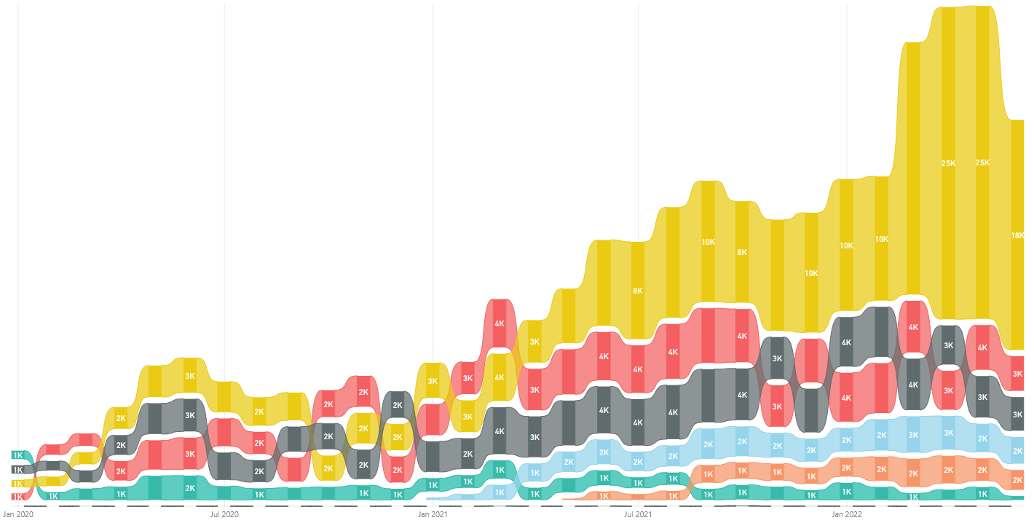
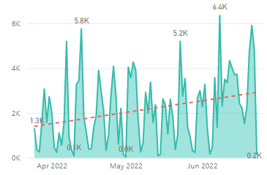
yo teams
V4 Released 🎉🎉🎉🎉
https://aka.ms/yoteams
generator-teams – The Teams apps generator
Package Downloads
📃 Docs published at https://pnp.github.io/generator-teams/
🚀 Latest release: 4.0.0 [2022-06-23]
Added `1.13` manifest Added `1.12` manifest Added `m365DevPreview` manifest Added component documentation for configuration and scaffolding details [Breaking] Upgraded Team JS SDK to version 2.0 (promises based) Updated all outdated references Manifest version 1.11 no longer selectable in scaffolding Default manifest version is 1.13 Added a warning regarding Connectors not working with Teams JS SDK 2.0 Calling bot support removed Viva Connections Tab scaffolding removed Removed individual component README files (available in Yo Teams docs) Fixed issue with telemetry timeout at the end of scaffolding
yoteams-build-core
yoteams-deploy
Daily build events
🚀 Latest release: 1.7.0 [2022-06-23]
Added support for Schema 1.13. Requires Node 14 or later Dependency package updates Fixed issue with telemetry timeout at the end of scaffolding
🔮 Preview: n/a 📅 Roadmap: ???
🚀 Latest release: 1.2.0 [2022-06-23]
Requires Node 14 or later Dependency package updates
🔮 Preview: : n/a
📅 Roadmap:
???

Slide 14
Microsoft Graph Toolkit Web Components powered by Microsoft Graph

Slide 15

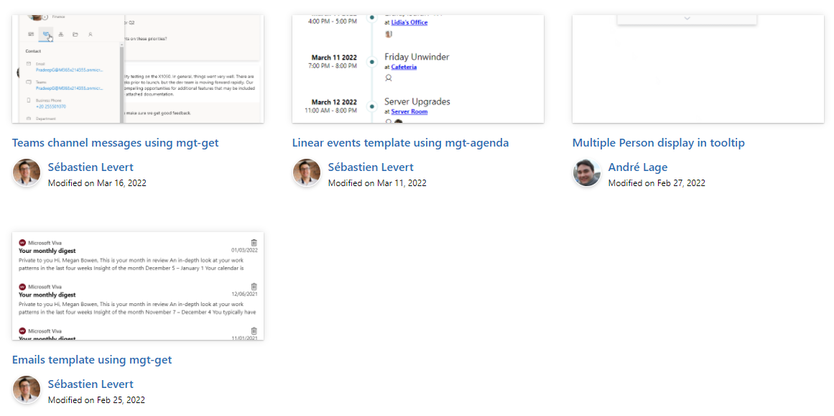

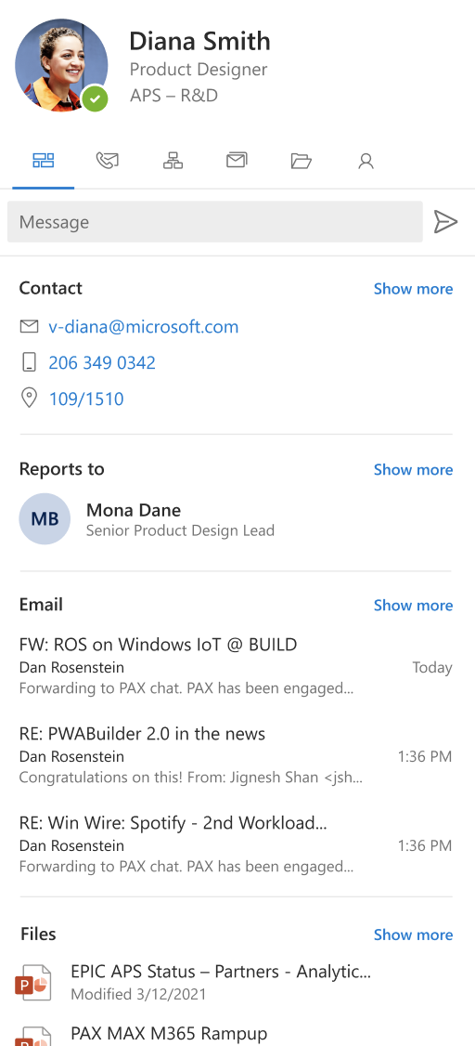
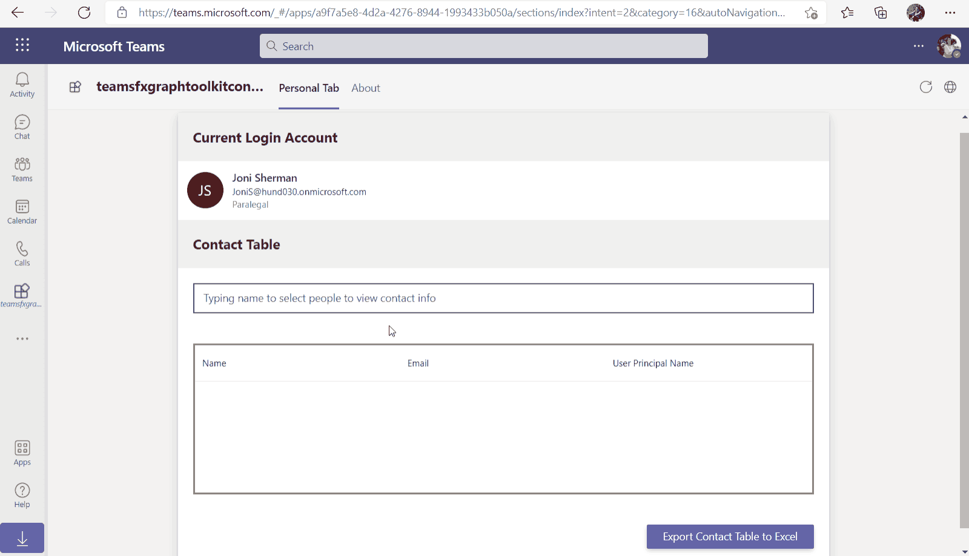
Microsoft Graph Toolkit
👀 More information: aka.ms/mgt
What’s new 🎉
The MGT samples repository is now LIVE! https://aka.ms/mgt/samples
v2.5.2 is our latest release! Update your packages! https://aka.ms/mgt/v2.5.2
Updates to our Msal2 and Teams providers
GA release of our TeamsFx provider
Thanks @jocsch, @stniemin and @estruyf for your contributions 🎉
Our playground is now a PWA! Have a look https://aka.ms/mgt/dev
What's next? 💻
Our 2.6.0 is coming very soon! Try it now! npm i @microsoft/mgt@next
Updates to our accessibility guidelines
SPFx 1.15 supported for out mgt-spfx package
Bug fixes
Aligning all Toolkit components to Fluent UI Web Components
More generic components and theming capabilities
We need your help ❤️
🐞 Help us fix bugs
🆕 Help us build/improve features
help-wanted & good-first-issue -> https://aka.ms/mgt/issues

Slide 16

Independent Publisher Connectors
What’s new
50 Awesome Independent Publishers!
147 Independent Publisher connectors!
15 New connectors:
Troy Taylor- Easyship
Troy Taylor- DadJokesIO
Troy Taylor- CarbonFootprint
Troy Taylor- Givebutter
Woong Choi- DHL Shipment Tracking
1 Update to existing connectors:
Mitanshu Garg- RegEx Matching
We need your help
Become an Independent Publisher by building one of these connectors: Top Connector Asks · microsoft/PowerPlatformConnectors Wiki (github.com)

Slide 17
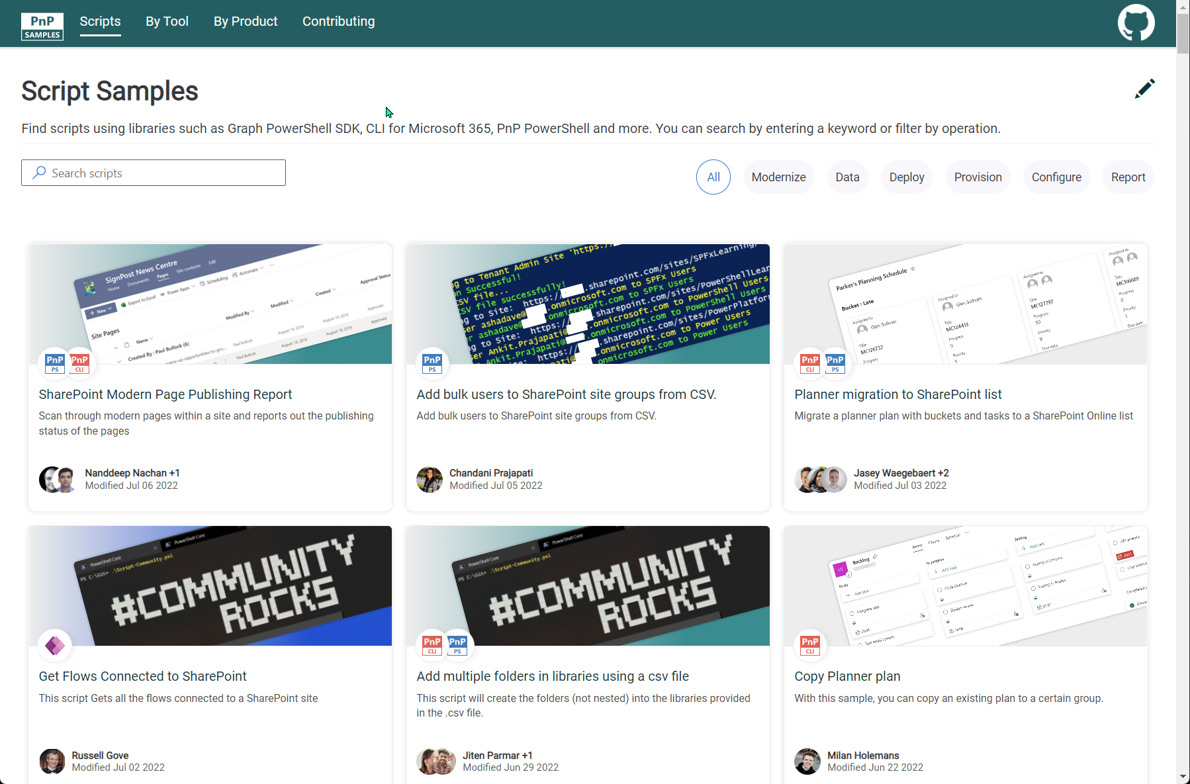


SCRIPT SAMPLES
One centralized location for all scripts for helping your day-to-day life. Contribution's welcome!
Site now has 155 scenarios and 237 scripts, using Microsoft Graph, CLI for Microsoft 365, PnP PowerShell, SPO Management Shell tooling and more…😁 AND samples integrated into "Unified" Solution Gallery
Awesome Samples Include :
New scenario using PnP PowerShell
Add bulk users to SharePoint site groups from CSV by Chandani Prajapati
New scenarios using Power App PowerShell SDK
Get Flows Connected to SharePoint by Russell Gove
Updated Scenarios with CLI for Microsoft 365 Scripts
Planner migration to SharePoint list By Jasey Waegebaert
SharePoint Modern Page Publishing Report by Nanddeep Nachan
Multiple Samples update – m365 connection check By Jasey Waegebaert
Copy Planner plan by Milan Holemans
Copy library view to another library(ies) by Reshmee Auckloo
Updated Scenarios with PnP PowerShell Scripts
Add multiple folders in libraries using a CSV file by Jiten Palmer
We have good first issue in the GitHub Repo with sample ideas of scripts you could write – thank you Adam Wójcik! https://github.com/pnp/script-samples
Thank you for your samples and contributions! 👏
good first issue
aka.ms/script-samples

Slide 18








Microsoft Teams Samples
Got a cool Teams app to share?
Please contribute – or make use of the samples yourself!
All the samples are at https://aka.ms/m365-samples
Teams samples w/filtering https://aka.ms/teams-samples
Thank You Community!
SAMPLES WANTED!
Notes:
Wajeed Shaikh – Teams PM

Slide 19
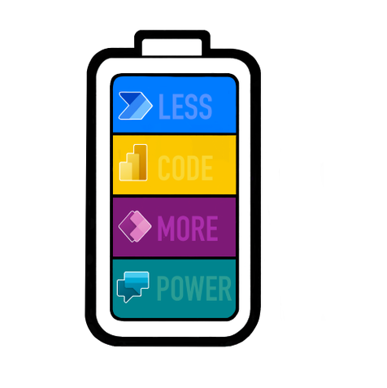
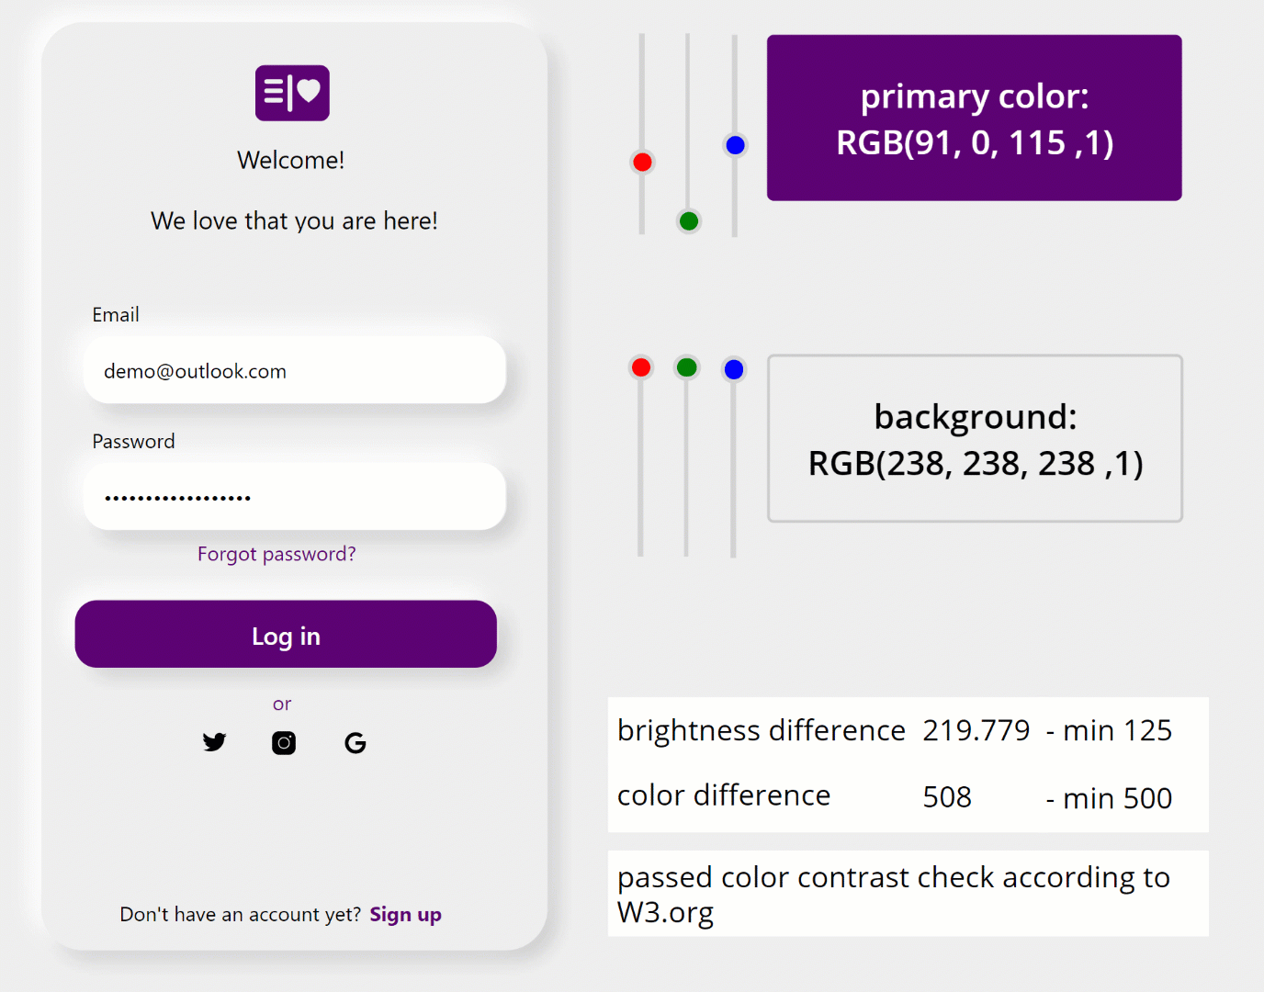



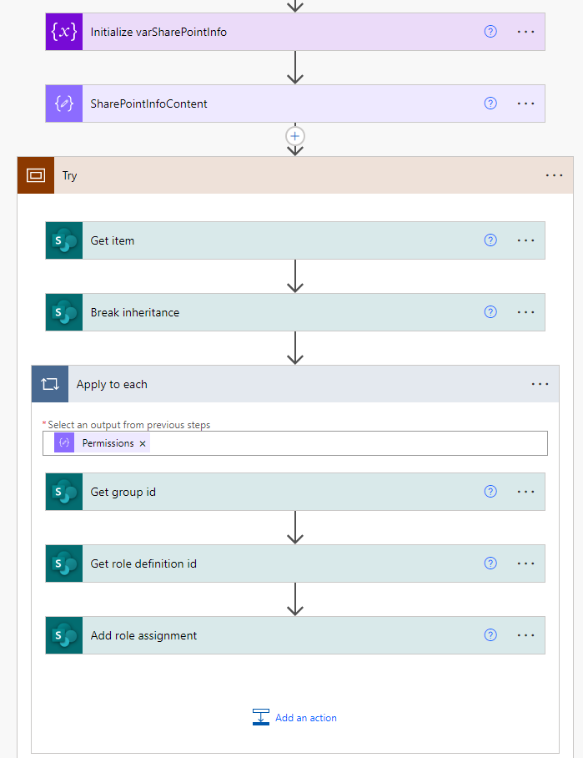
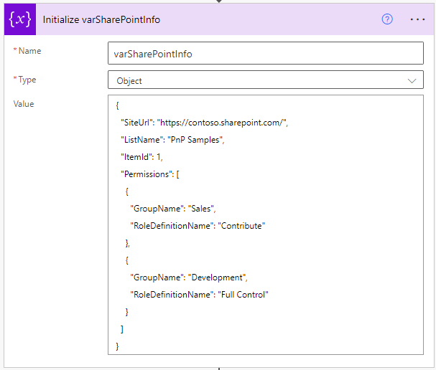
Power Platform Samples
New:
Accessibility color checker Luise Freese | @LuiseFreese
Power Automate – Set SharePoint item level permissions Ramin Ahmadi | @raminahmadi1986
Join the Power Platform Contributors
Sharing is Caring Session – July 20th
aka.ms/powerplatform-samples ​
Notes:
These are the updates that we processed since out last call.
New samples:
- Power Automate: SharePoint Collect Feedback April Dunnam | @aprildunnam Demonstrates:
Executing a Flow from a SharePoint Library with input parameters
Leveraging the custom responses option in Power Automate approvals
https://github.com/pnp/powerautomate-samples/tree/main/samples/sharepoint-collect-feedback
- Power Automate: Get Graph API Data within Power BI Reports Scott McKenzie | @365EDUBI Enables Graph API data to be refreshed within the Power BI Service. https://github.com/pnp/powerautomate-samples/tree/main/samples/graph_api_in_power_bi
Updated samples:
Power App: Fluent UI Custom Theme Fabio Franzini | @franzinifabio Fixed datepicker control theme https://github.com/pnp/powerapps-samples/tree/main/samples/fluentui-custom-theme
These latest samples should show within 24 hours

Slide 20


Optional picture time!
Video on and we’ll grab a Together Mode pic with those who are willing to do this.
We are together on this as a community!
By enabling your camera for the picture, you’ll give us the permission to share your picture in social media.

Slide 21
DEMO
Independent Publishing Connectors - Mailjet Demo – Clément Olivier
How Microsoft Graph “Sites.Selected” work for granular permissions in SharePoint Online – Pankaj Surti
List Formatting - Warrior Horse Return – Chris Kent

Slide 22

Q&A

Slide 23
Thank you
Recording will be available in 24 hours on
Microsoft 365 Community (PnP) YouTube channel
https://aka.ms/m365/videos
(subscribe today)
Follow us on Twitter
@Microsoft365Dev | @M365PnP
Next M365 General Dev call: July 21st at 07:00am PT
Next Viva Connections & SharePoint Framework call: July 14th at 07:00am PT
See all other community calls from https://aka.ms/m365/calls

Slide 24



Slide 25
Thank you

